Slide 1

Sur Tarang
A cross-modal, collaborative and bio-feedback informed Hindustani classical performance system
Interactive Music Final Project
Group 7
Nitin Hugar | Rhythm Jain | Thiago R Roque

Slide 2
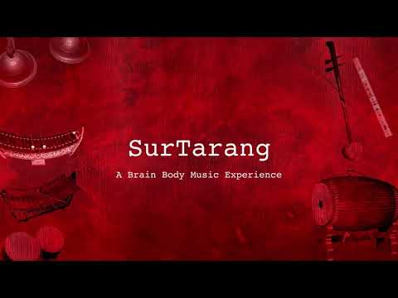
Demo
Watch Video

Slide 3
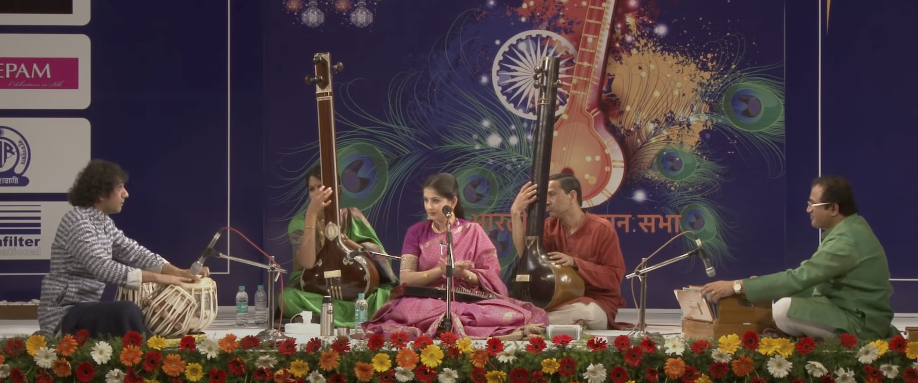
Concept
Sur Tarang was developed focused on the Indian classical singer due to the sounds and timbres integrated into the system.
Tanpura
Swarmandal
Tabla
Harmonium
A typical Hindustani Classical music concert.
Notes:
Section A :Alaap
(Unmetered)

Slide 4
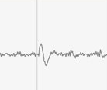


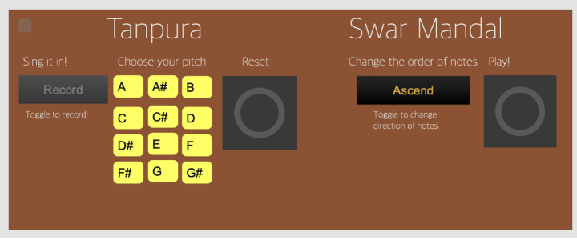



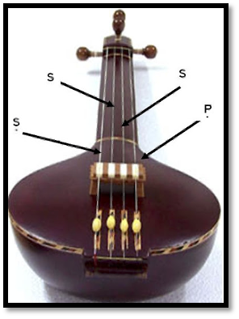
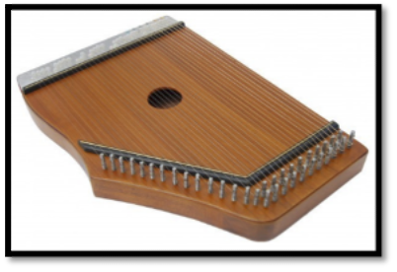
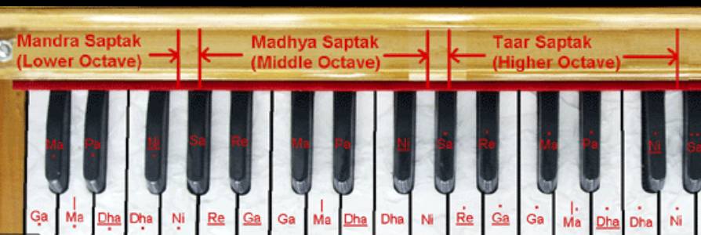
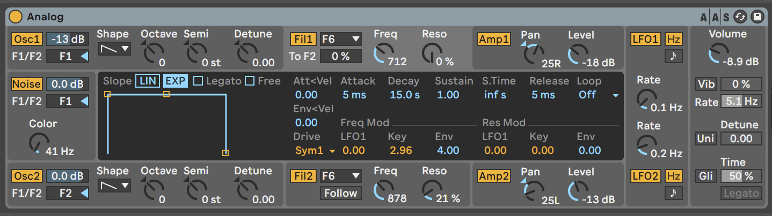
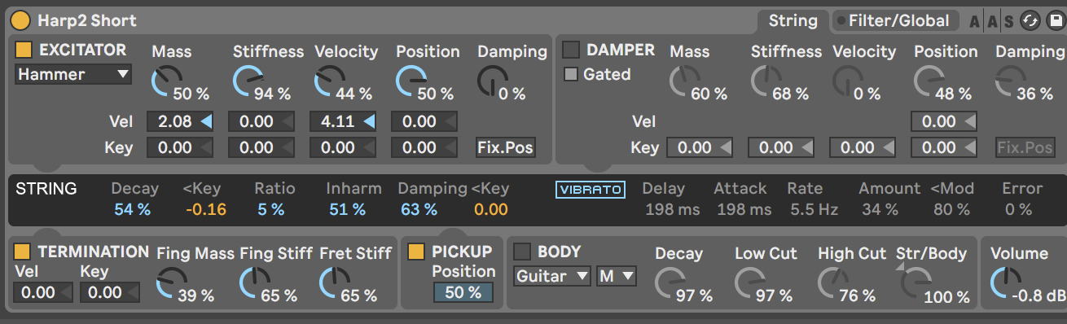
Melodic synthesis
relative
MIRA frame

Slide 5
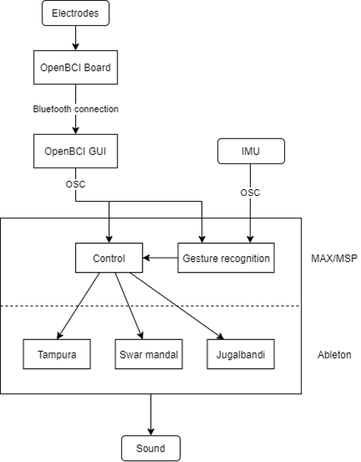
The 3 modules
Input module takes input from bio signals and gesture tracking
Processing module scales, manipulates, and adds relevant mapping to the inputs.
Sound engine maps the signals to interesting and relevant timbral layers.

Slide 6
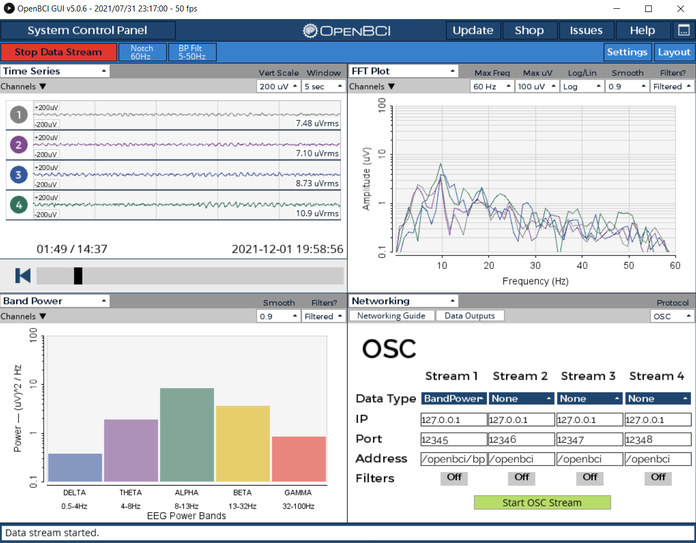
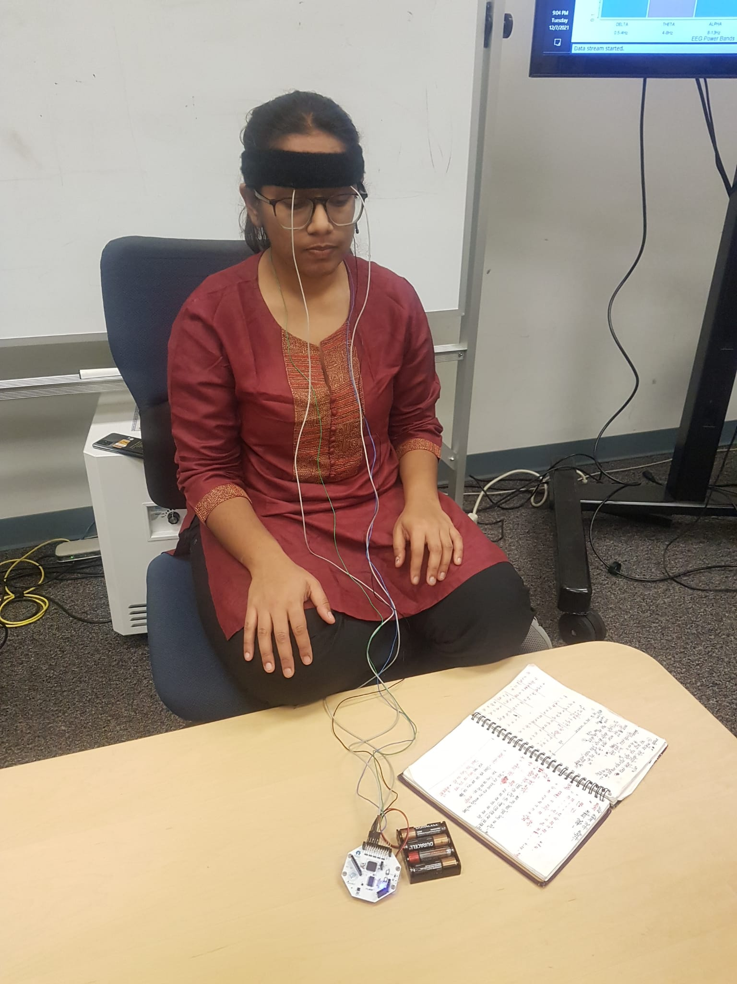
Brain Mapping

Slide 7
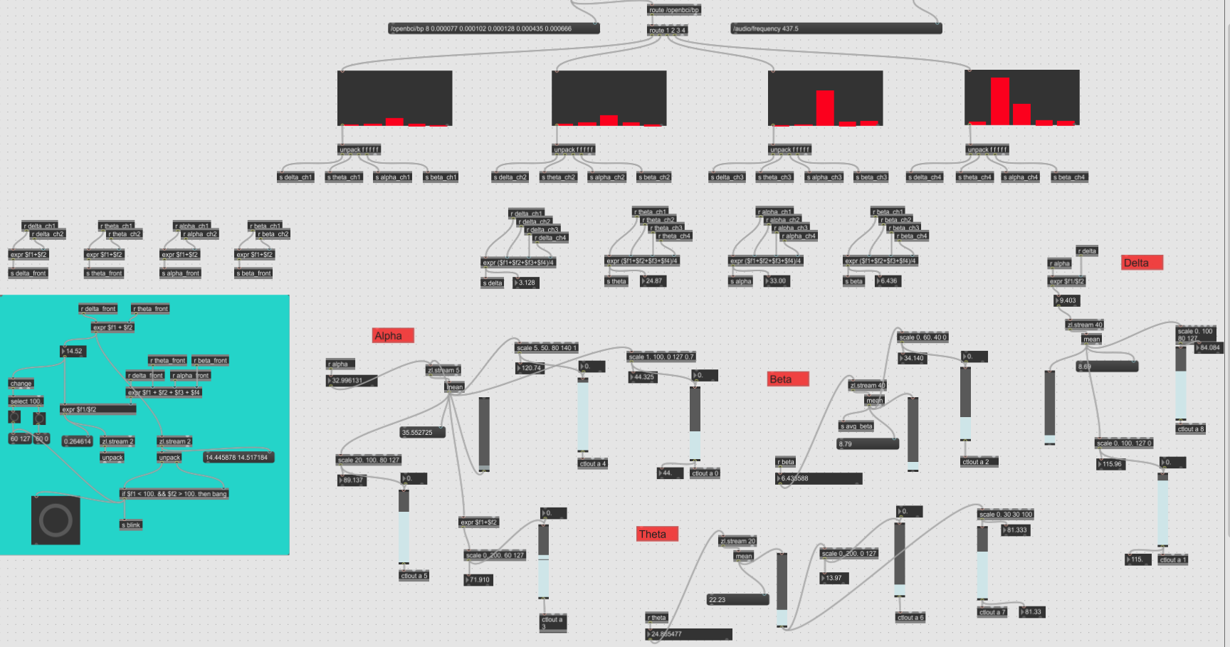
Brain Mapping

Slide 8
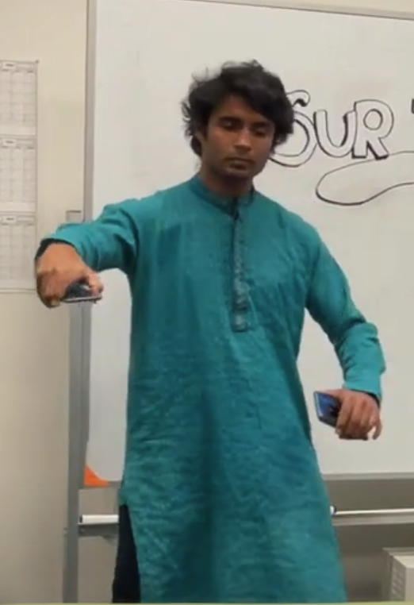
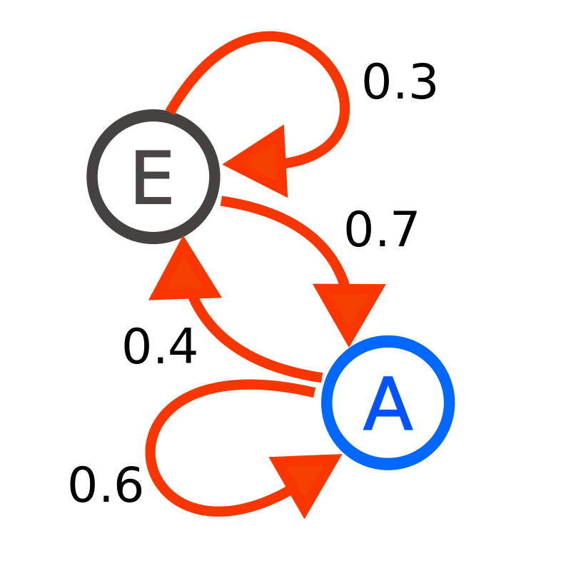
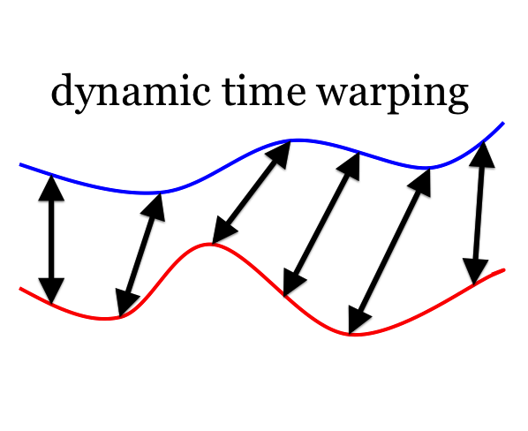
IMUs and Gestures
markov chain

Slide 9
Evaluation
Floor is low from the perspective of the performer, but requires practice for setup
High ceiling due to biofeedback practice – consciously control brain waves requires meditation practice.
Actual system accomplishes objective of sonifying mental states of the performer, but tests must be done for different performers for a more general system.
Gesture recognition system can be easily trained for more general gestures

Slide 10
Challenges
Hard to get clean EEG signal with passive electrodes
Body movements generate artifacts on EEG signal
Hard to get meaningful mappings from brain waves to sound
Highly subjective
Requires a lot of training on the performer's end to replicate even once you understand the trend.

Slide 11
Future Work
Include other bio-signals as electrocardiogram (ECG) or electrodermal activity (EDA)
Experiment with different techniques to sonify bio-signals
Machine Learning for mental states recognition and sonification
Cross-synthesis
Extension to more raags and moods
Add controllability to percussion

